Slide 1
Cloud

Slide 2
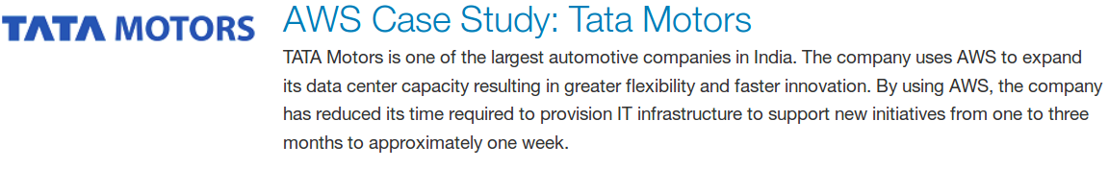
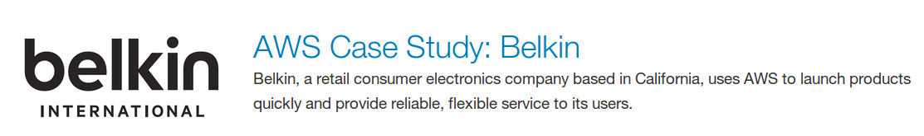
Time to Market
Notes:
https://aws.amazon.com/solutions/case-studies/tata-motors/
https://aws.amazon.com/solutions/case-studies/belkin/
https://aws.amazon.com/solutions/case-studies/91app/

Slide 3
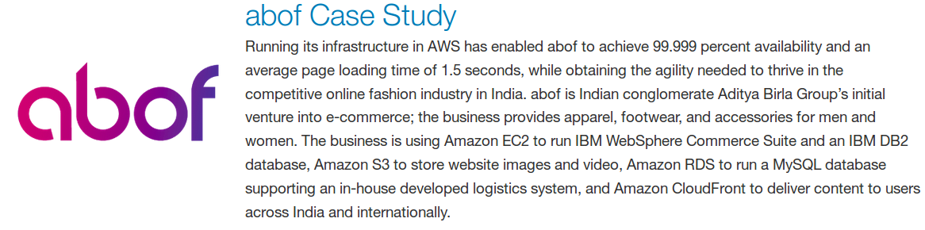
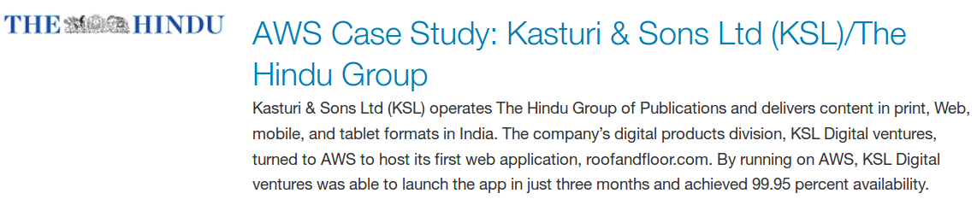
Availability
Notes:
https://aws.amazon.com/solutions/case-studies/AirWorks/
https://aws.amazon.com/solutions/case-studies/hindu-group/
https://aws.amazon.com/solutions/case-studies/abof/

Slide 4
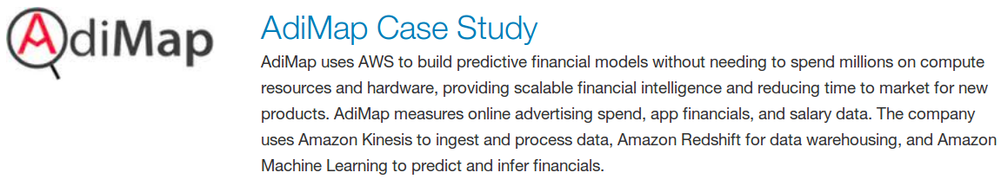
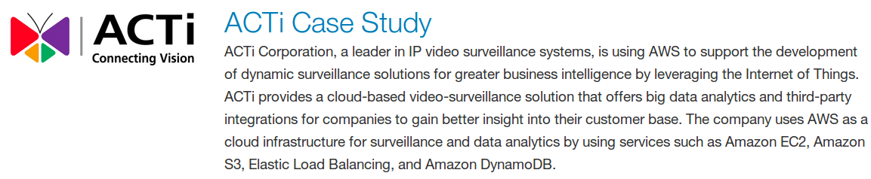
POC/ Evaluating New Tech
Notes:
https://aws.amazon.com/solutions/case-studies/adimap/

Slide 5
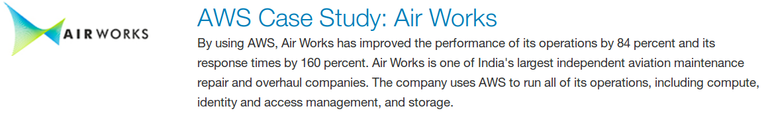
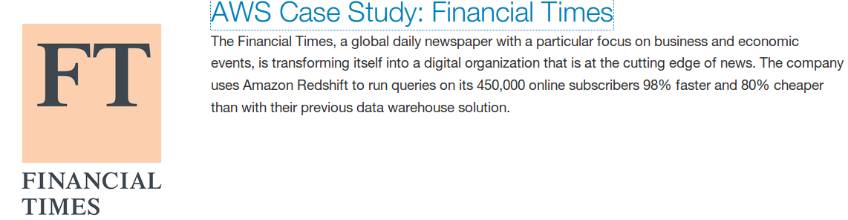
Performance
Notes:
https://aws.amazon.com/solutions/case-studies/AirWorks/
https://aws.amazon.com/solutions/case-studies/alcatel-lucent/
https://aws.amazon.com/solutions/case-studies/financial-times/

Slide 6
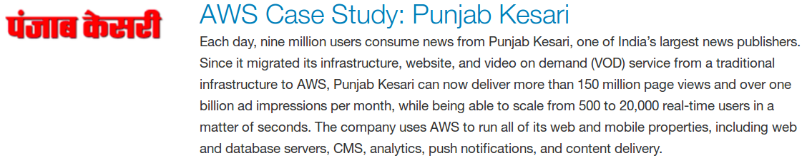
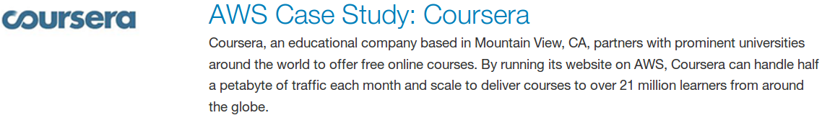
Scale
Notes:
https://aws.amazon.com/solutions/case-studies/6waves/
https://aws.amazon.com/solutions/case-studies/punjab-kesari/
https://aws.amazon.com/solutions/case-studies/adroll/
https://aws.amazon.com/solutions/case-studies/coursera/
https://aws.amazon.com/solutions/case-studies/netflix-and-aws-lambda/
https://aws.amazon.com/solutions/case-studies/imdb/

Slide 7
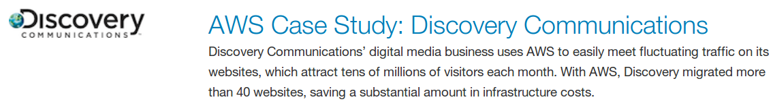
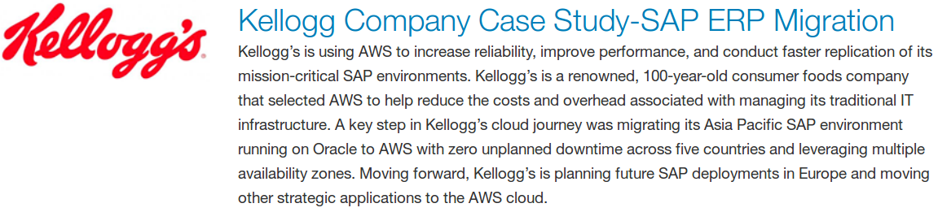
Cost
Notes:
https://aws.amazon.com/solutions/case-studies/3dduo/
https://aws.amazon.com/solutions/case-studies/kellogg-company-case-study-sap-erp-migration/
https://aws.amazon.com/solutions/case-studies/discovery-communications/
Further Case Studies
Security
Universal Access
Storage

Slide 8

What is cloud
Cloud computing is a general term for the delivery of hosted services over the Internet.
Cloud computing enables companies to consume compute resources as a utility -- just like electricity -- rather than having to build and maintain computing infrastructures in-house.

Slide 9
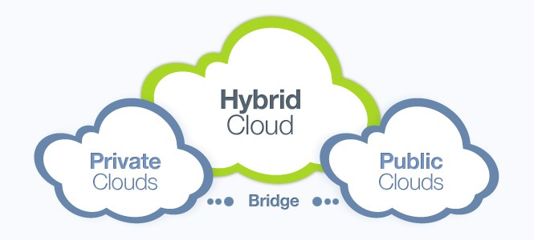
Public, Private & Hybrid Cloud
Notes:
Talk about trend how for different companies different combination makes sense, especially in terms of startup and when that company has grown to a signicant size
Why Cloud
Reduction of costs – unlike on-site hosting the price of deploying applications in the cloud can be less due to lower hardware costs from more effective use of physical resources.
Universal access - cloud can allow remotely located employees to access applications and work via the internet.
Security- Cloud computing gives you greater security when this happens. Because your data is stored in the cloud, you can access it no matter what happens to your machine.

Slide 10
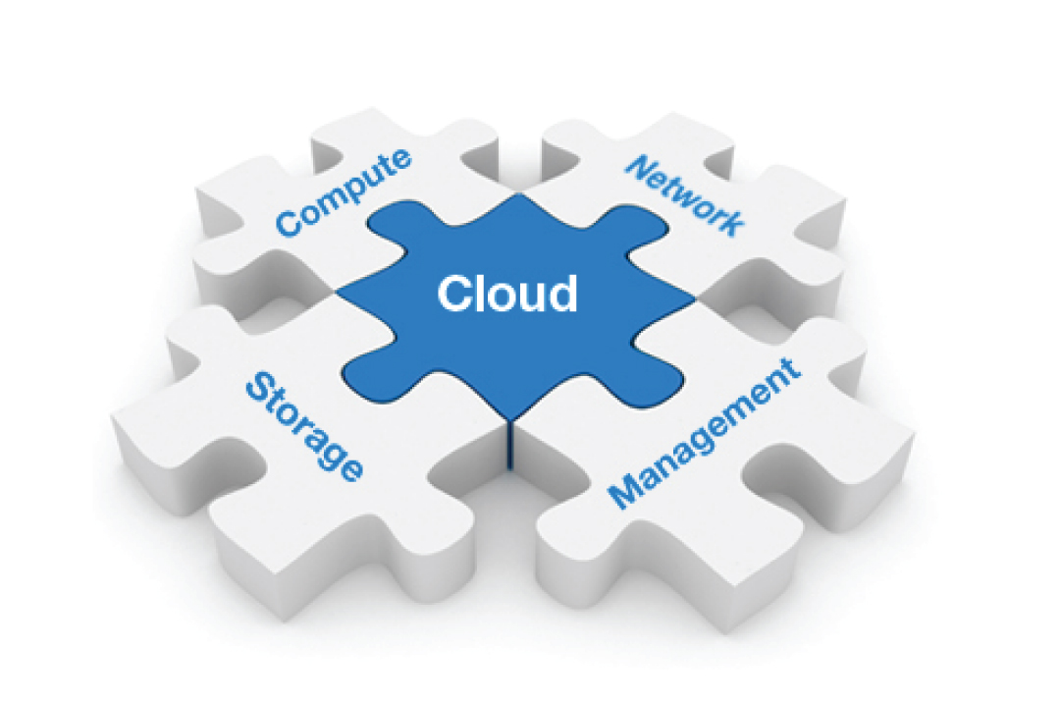
Cloud service provider
Amazon Web Services
Rackspace
DigitalOcean
Google Compute Engine
Brightbox
CloudBees
IBM Cloud

Slide 11
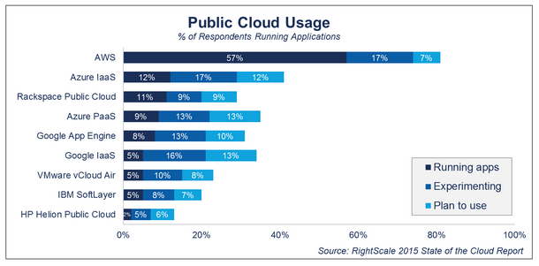
Notes:
http://www.rightscale.com/blog/cloud-industry-insights/cloud-computing-trends-2015-state-cloud-survey
https://www.channele2e.com/2016/02/04/cloud-market-share-2016-aws-microsoft-ibm-google/

Slide 12
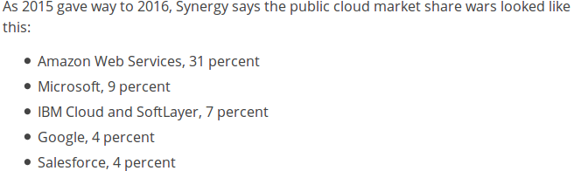
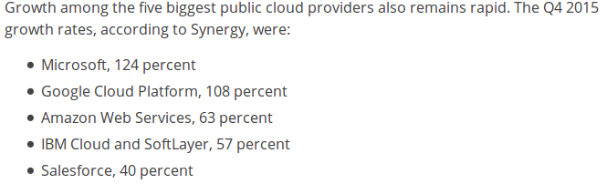
Notes:
https://www.channele2e.com/2016/02/04/cloud-market-share-2016-aws-microsoft-ibm-google/
At first glance, those are healthy numbers for each of the five biggest public cloud providers. But take a closer look and the overall numbers suggest:
In terms of raw dollars, Amazon is still growing faster than its rivals.
No. 2 player Microsoft is extending its lead over No. 3 player IBM.
No. 4 player Google could close the gap with No. 3 player IBM this year.
No. 5 player Salesforce — while extremely healthy in the SaaS market — like lacks the IaaS scale needed to catch up with the other four players.

Slide 13
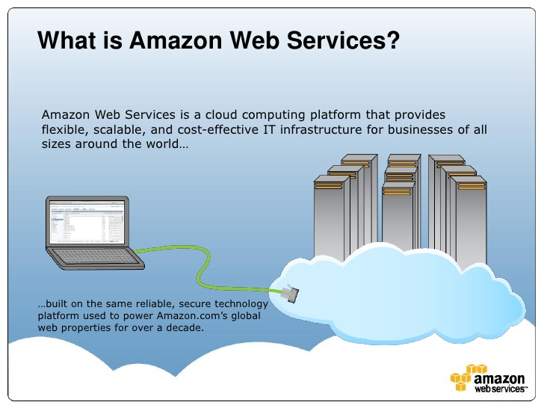
AWS: Amazon Web Service

Slide 14
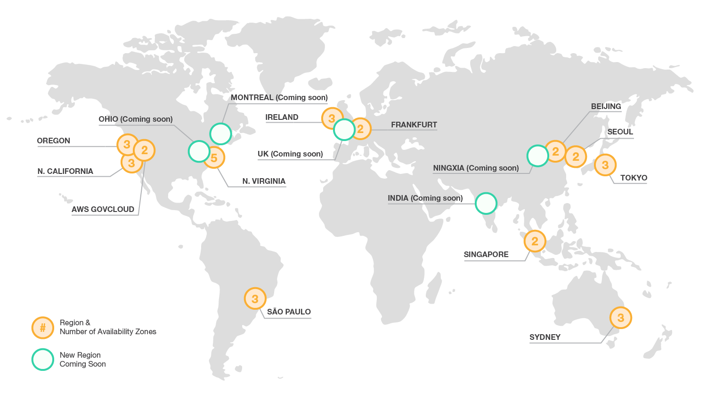
AWS – Global Presence

Slide 15
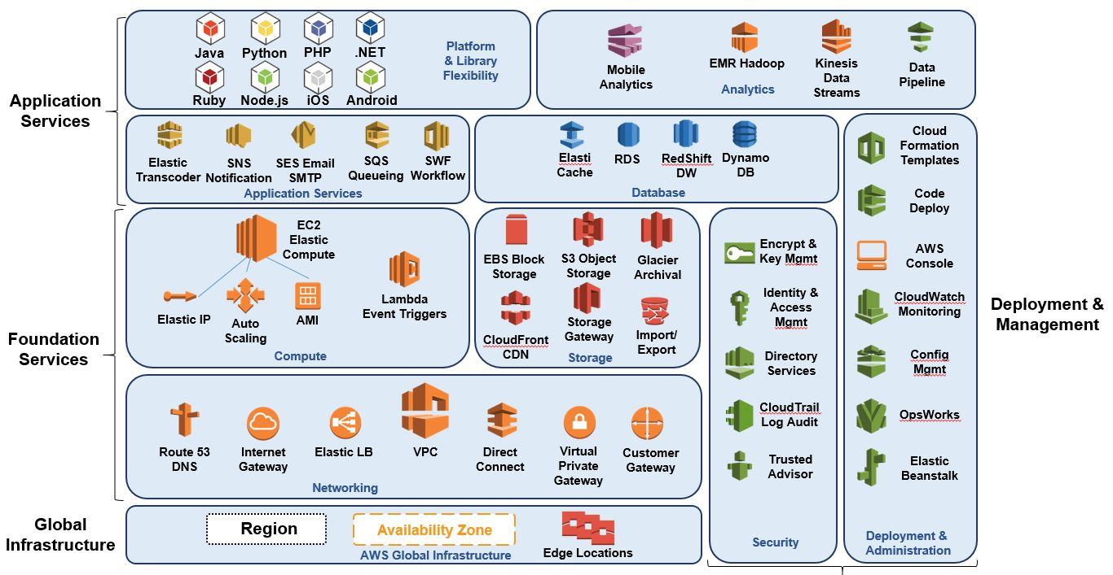
AWS Services

Slide 16
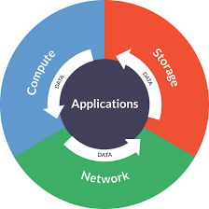
What makes a running system ?

Slide 17
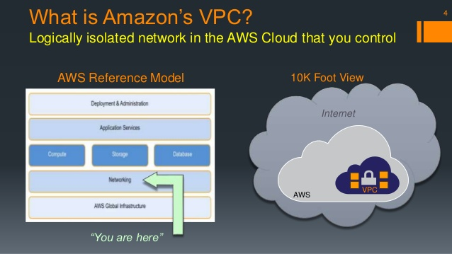
VPC

Slide 18
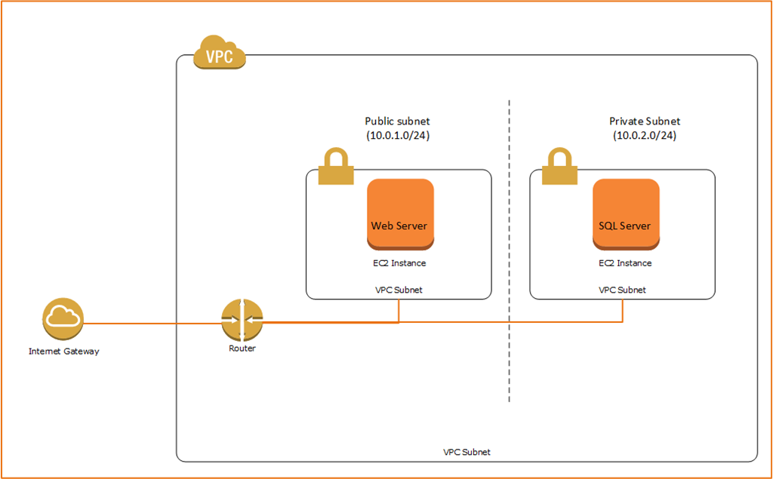
VPC: Subnets

Slide 19
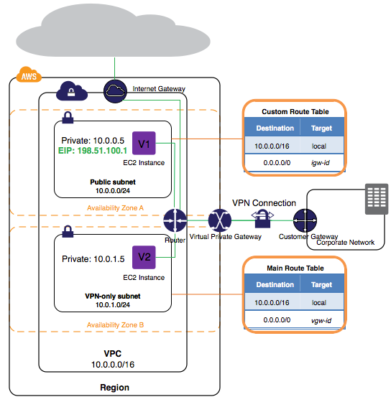
VPC: Route Tables

Slide 20
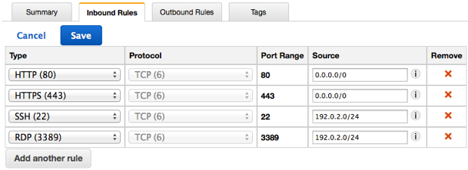
VPC: Security Groups

Slide 21
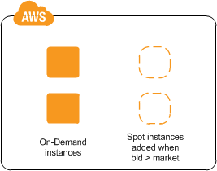

EC2: Instances

Slide 22
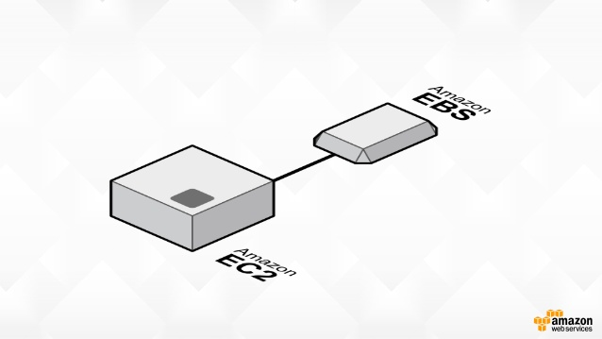
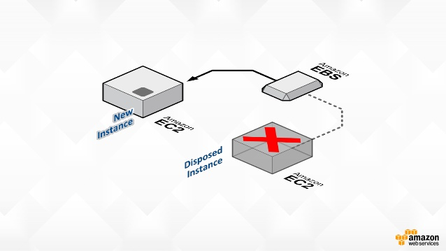
EBS

Slide 23
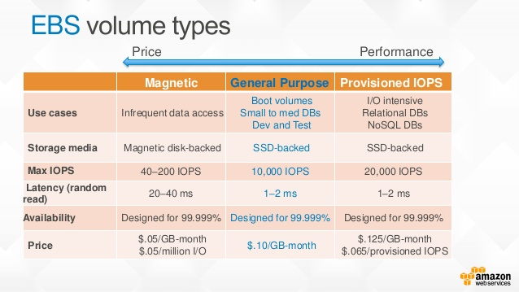
EBS

Slide 24
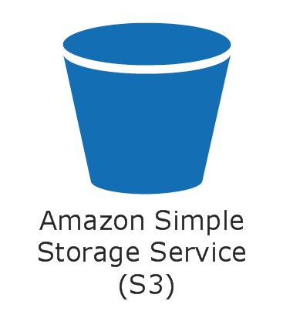
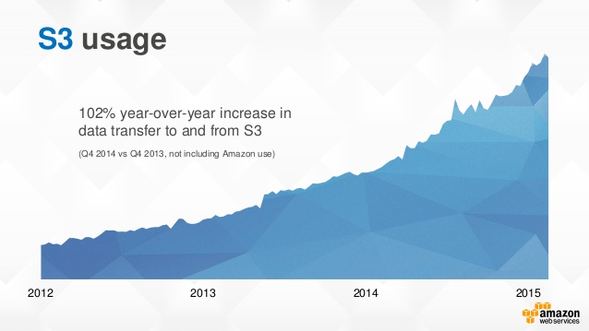
S3

Slide 25
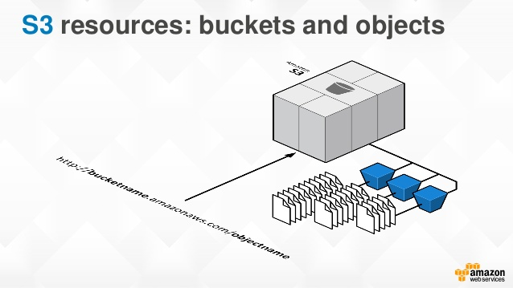
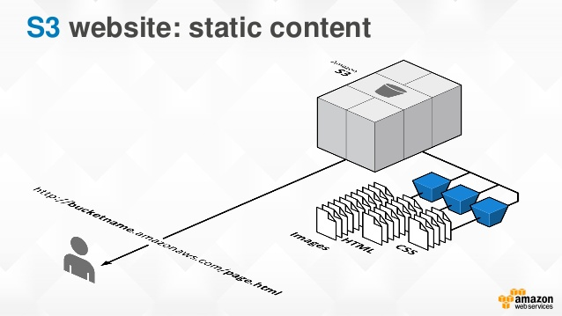
S3

Slide 26
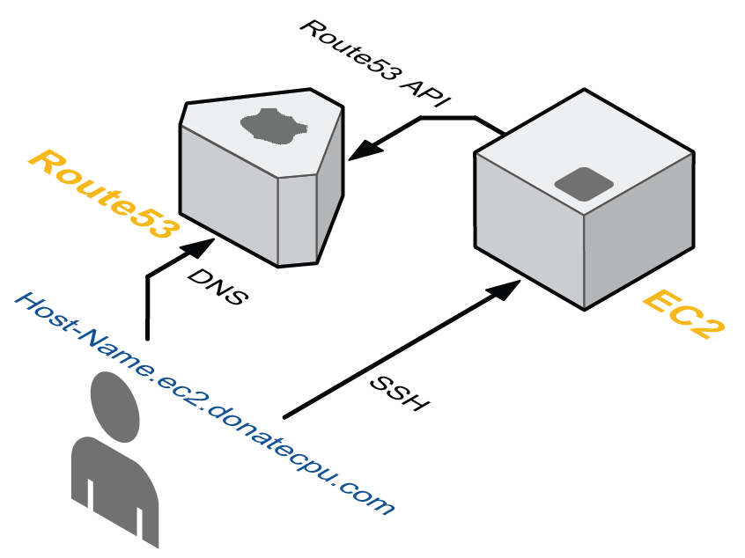

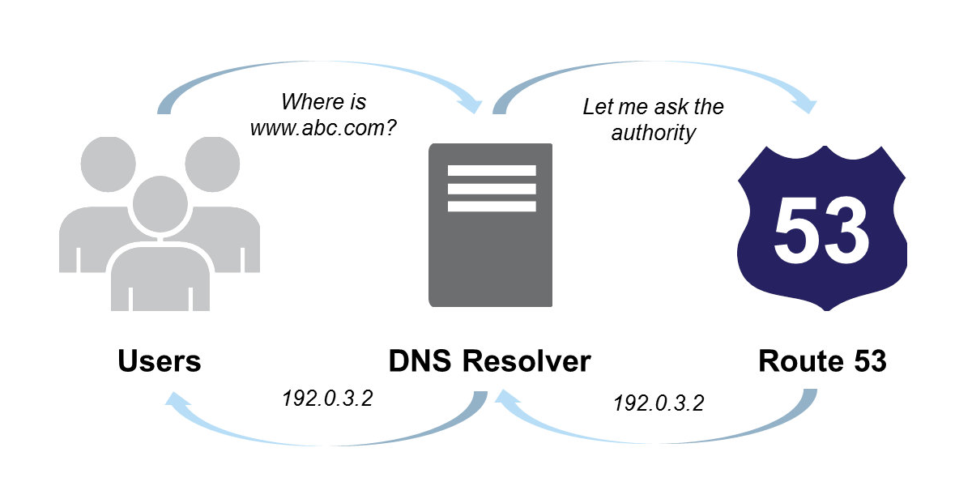
Route53

Slide 27

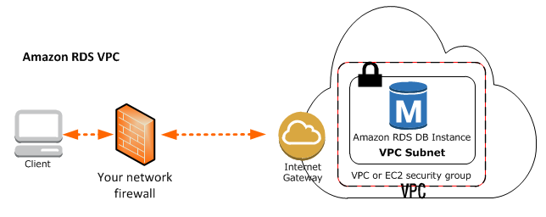
RDS

Slide 28

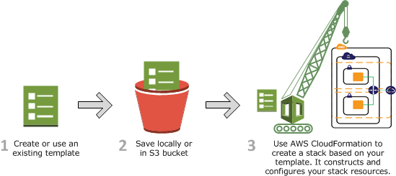
CFN

Slide 29

Hands on
Create a VPC
Specify Subnet(CI/DR)
Configure Route Tables
Launch EC2 instances in public and private subnet

Slide 30
Advanced Topics
CloudWatch
Auto Scaling
IAM
OpsWorks
CloudFront

Slide 31

Questions ?

